Slide 1

DEPARTMENT CONVENTION · POST OFFICER TRAINING
Community Service Reporting
VFW Department of South Carolina
2026–2027 Program Year
Community Service is one of the most visible ways our Posts demonstrate the VFW mission. Every hour volunteered, every mile driven, and every dollar donated tells the story of veterans continuing to serve — and accurate reporting ensures those efforts receive the recognition they deserve.
Notes:
Community Service is much more than paperwork. It documents the tremendous impact that VFW Posts and Auxiliaries have throughout South Carolina. Every food drive, flag retirement ceremony, veteran hospital visit, youth program, and community project demonstrates that veterans continue serving long after their military careers end. Our goal today is to make reporting simple, accurate, and consistent.

Slide 2
REPORTS DUE
All-State Community Service Requirements
DEADLINE All reports must be submitted by April 27, 2027
Each Post must submit each program year:
5
4
4
12
Community Service Reports
Americanism Reports
Youth Activities Reports
Safety Reports
each quarter
each year
each year
each year
These reports are required for:
All-State consideration
All-American consideration
Department recognition
VFW Department of South Carolina · Community Service Reporting
2
Notes:
Meeting these reporting requirements is just as important as conducting the activities themselves. Outstanding Posts sometimes miss recognition simply because they failed to submit reports. Don't wait until April — report activities throughout the year.

Slide 3
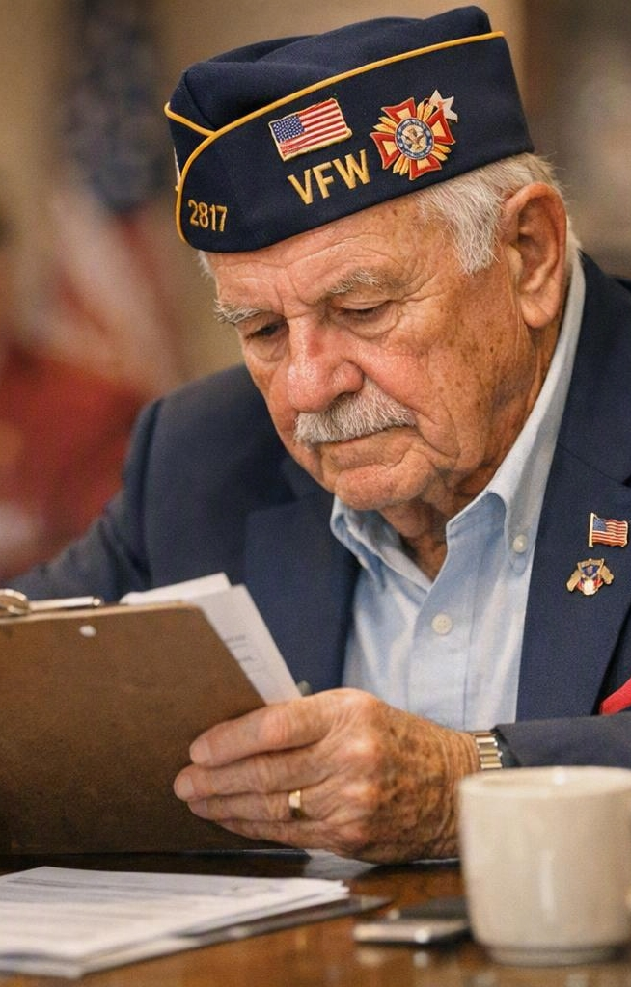
APPOINT A LEADER
Every Post Needs a Community Service Chairman
The Post Commander should appoint a Community Service Chairman who will:
Collect reports from Post members
Collect reports from the Auxiliary
Maintain Community Service Report Forms
Submit reports electronically on VFWSC.org
Keep reporting current throughout the year
BEST PRACTICE
Have report forms available at every meeting.
Notes:
Reporting works best when one individual is responsible for collecting information. Encourage members to complete individual report forms immediately after activities instead of trying to remember months later.

Slide 4
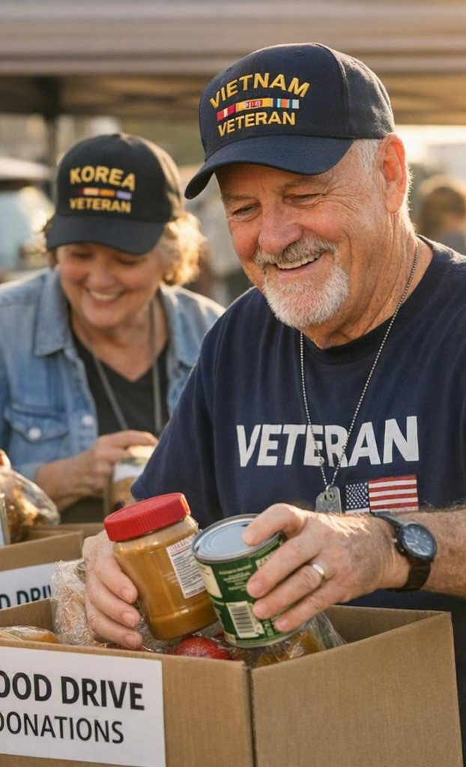
WHAT COUNTS
What Should Be Reported?
Community service includes activities such as:
Veteran assistance
Community clean-up projects
Blood drives
Food collections
Disaster relief
Nursing home visits
School presentations
Flag ceremonies
Youth mentoring
Holiday assistance
Memorial ceremonies
REMEMBER
If your Post improves your community or supports veterans — it probably qualifies.
Notes:
Many Posts do far more community service than they actually report. If your members donate time, talent, or resources to improve the lives of veterans or your community, chances are it should be reported.

Slide 5

THE BIGGER PICTURE
Why Reporting Matters
National VFW compiles every report submitted — turning local service into a national story.
PRESENTED ANNUALLY TO
THE REPORTS DEMONSTRATE
Congress
The Department of Veterans Affairs
National leadership
Community partners
Millions of volunteer hours
Millions of dollars donated
Significant cost savings to government
The continuing value of the VFW
These reports also help protect our organization's tax-exempt status.
VFW Department of South Carolina · Community Service Reporting
5
Notes:
These reports are not just statistics — they prove the value of the Veterans of Foreign Wars. They show Congress that America's veterans continue serving their communities every day.

Slide 6
INTEGRITY FIRST
Honest and Accurate Reporting
Report only actual activities.
NEVER
Inflate hours
MILEAGE IS AUTOMATIC
National automatically calculates mileage reimbursement — never add gasoline expenses yourself.
Estimate excessive mileage
Duplicate reports
WHY IT MATTERS
Accuracy protects the integrity of our organization. The VFW can be audited by the IRS.
Count the same volunteers twice
Include gasoline expenses
VFW Department of South Carolina · Community Service Reporting
6
Notes:
Our credibility depends on honest reporting. The VFW could be audited by the IRS, so every report must accurately reflect what actually occurred.

Slide 7
COMMON MISTAKE
Avoid Double Reporting
EXAMPLE Your Post marches in a Veterans Day Parade and invites a Scout Troop to participate.
Report #1 — Americanism
Report #2 — Youth Activities
Record the full activity:
Description only — enter ZERO for:
Hours
Members
Miles
Dollars
Hours
Members
Miles
Dollars
The activity is reported twice — but the volunteer time is counted only once.
VFW Department of South Carolina · Community Service Reporting
7
Notes:
This is one of the most common reporting mistakes. The event may fit multiple program categories, but the volunteer hours, mileage, and expenses can only be counted once.

Slide 8
ONLINE REPORT · THE ACTUAL FORM
What the Online Report Form Looks Like
VFWSC.ORG · COMMUNITY SERVICE REPORT
Post*
District*
Select a Program*
1234
5
Community Service
Americanism
Submitter Email*
Youth Activities
Safety
chairman@post1234.org
Veterans and Military Support
Voice of Democracy
Date of Activity*
Patriot's Pen
Teach Scout
mm/dd/yyyy
Cumulative Hours*
Miles*
Description*
0
0
Describe how this activity meets the conditions of the category — what happened, who benefited, and the Post's role.
Members*
Dollars Spent/Donated*
0
0
VFW Department of South Carolina · Community Service Reporting
8

Slide 9
ONLINE REPORT · 1 OF 3
Tell the Activity Story Clearly
Three entries establish what happened and who served.
START HERE Open VFWSC.org and select the Community Service Report.
A CLEAR DESCRIPTION ANSWERS
01
DESCRIPTION
Explain what happened, who benefited, and the Post’s role. Write so someone outside the Post can understand it.
1
What happened?
2
Who benefited?
02
MEMBERS
Count each participating member once for this activity. Do not repeat the same volunteers on another report.
3
What did the Post do?
03
HOURS
Enter the actual time volunteered. If another report receives the credit, enter zero here.
ONE ACTIVITY, ONE SET OF TOTALS
Volunteer credit is counted only once.
VFW Department of South Carolina · Community Service Reporting
9

Slide 10
ONLINE REPORT · 2 OF 3
Use Actual Travel and Dollar Totals
Enter real amounts—never estimates or padded figures.
04
MILES
05
DOLLARS
Enter travel connected to the activity. National calculates mileage reimbursement automatically—never add gasoline expenses.
Enter the actual dollars donated for the activity. Do not estimate or inflate the amount.
IF THE SAME ACTIVITY APPEARS ON A SECOND REPORT
Enter the description again, but use zero for members, hours, miles and dollars on the second report.
VFW Department of South Carolina · Community Service Reporting
10

Slide 11
ONLINE REPORT · 3 OF 3
Review Once, Then Submit
A final check protects the Post and the integrity of the VFW.
01
02
03
MATCH THE STORY
VERIFY THE NUMBERS
SUBMIT & STAY CURRENT
The description and totals refer to the same activity.
Members, hours, miles and dollars are actual and not duplicated.
Send the report electronically on VFWSC.org and report throughout the year.
FINAL CHECK
No duplicate credit. No gasoline expense. No inflated totals.
VFW Department of South Carolina · Community Service Reporting
11

Slide 12
MEET THE REQUIREMENT
Safety Reporting
12
Safety Reports each year
Make safety a standing agenda item at every monthly meeting.
Possible Safety Topics
Heat injuries
Fire prevention
NATIONAL GUIDANCE
Only the individual giving the safety briefing receives volunteer credit.
Winter driving
Hurricane preparedness
EXAMPLE — 3-minute briefing
Enter 0.05 hours
Enter 1 member
Report only the speaker's mileage
Medication safety
Fall prevention
VFW Department of South Carolina · Community Service Reporting
12
Notes:
If every monthly meeting includes a brief safety presentation, your Post automatically meets the annual requirement. It only takes three to five minutes each month.

Slide 13
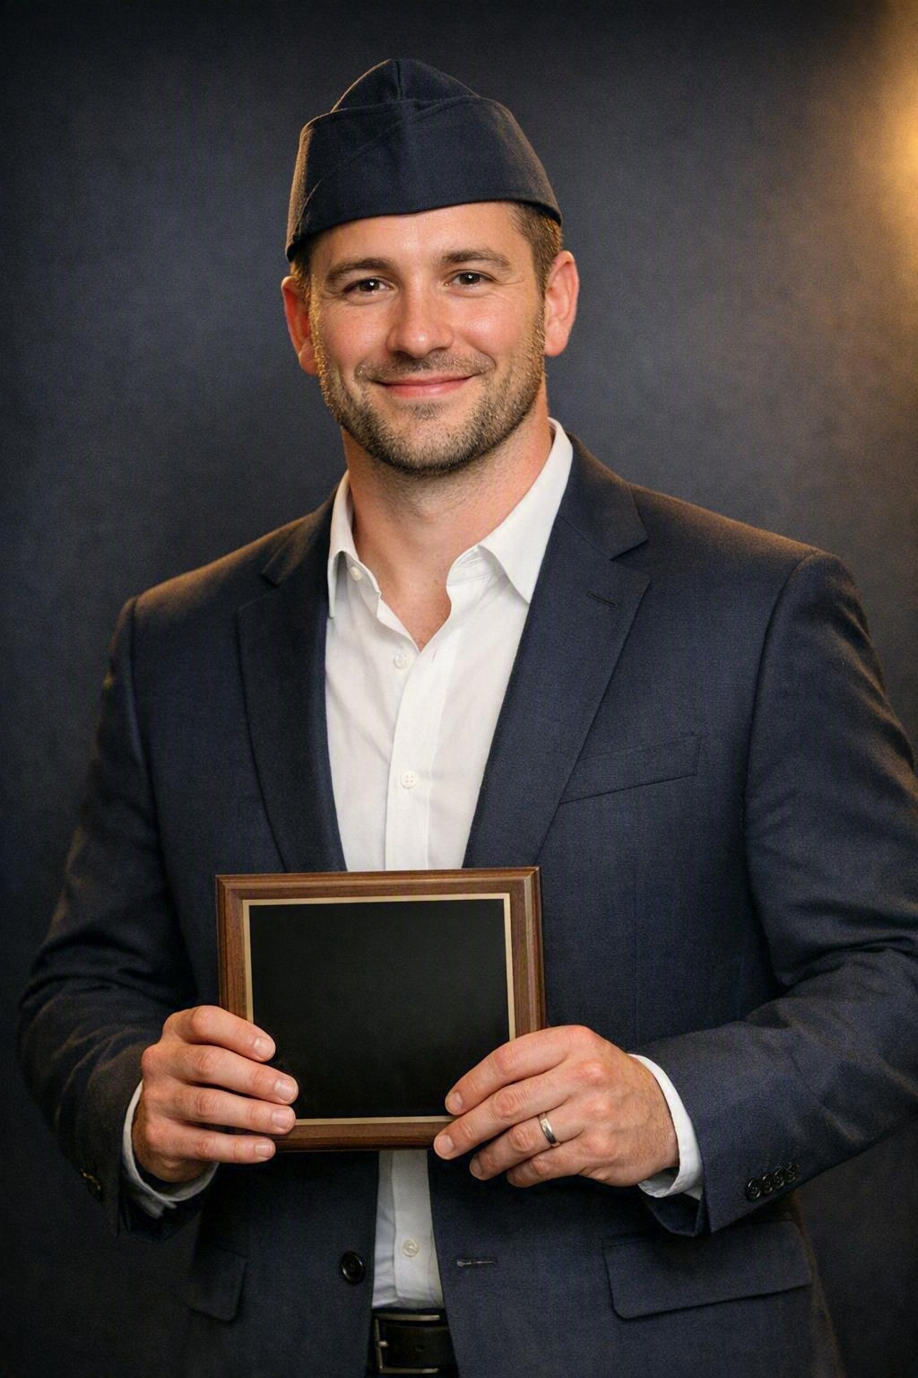
RECOGNITION
Awards & Recognition
Outstanding reporting can lead to:
Department Awards
The Clyde Lindsay Award
Department Outstanding Community Service Post
National recognition as Outstanding Community Service Post
Department dashboards also display:
Total hours
Total members
Total dollars
Comparative Post statistics
VFW Department of South Carolina · Community Service Reporting
13
Notes:
Good reporting benefits your Post. Recognition brings positive attention to your members and highlights the tremendous work being done across South Carolina.

Slide 14
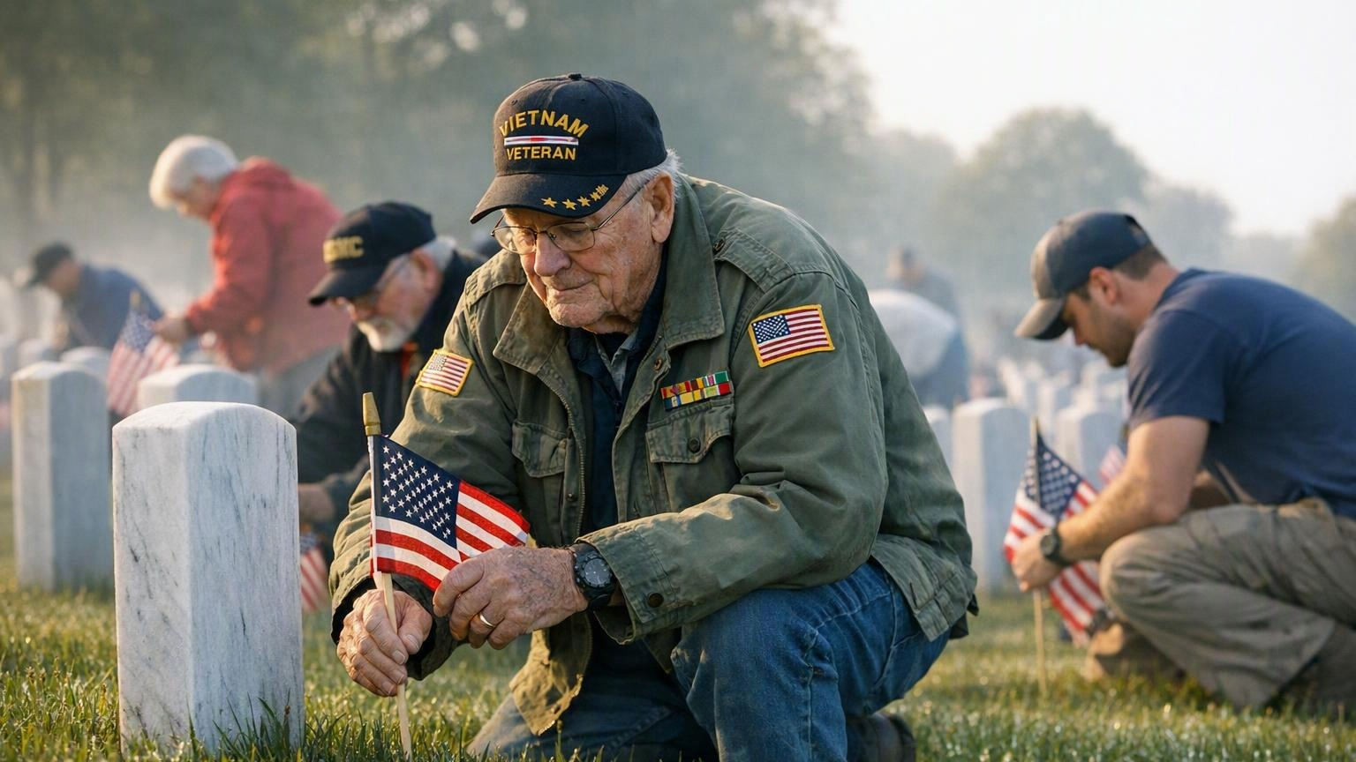
KEY TAKEAWAYS
What Every Post Should Remember
Appoint a Community Service Chairman
Keep report forms available at every meeting
REPORTS DUE
April 27, 2027
Submit reports throughout the year
Report accurately and honestly
Avoid double reporting
Meet all required report deadlines
“If it isn't reported, it didn't happen.”
Notes:
Our Posts already perform incredible service every day. Our responsibility is simply to ensure those efforts are documented. Accurate reporting honors our members, strengthens the VFW, supports our standing with Congress and the VA, and helps earn the recognition our Posts deserve. Thank you for everything you do in continuing to serve our veterans, our communities, and our nation.

Slide 15
COMMUNITY SERVICE · CONTACT
I am Nick Camera,
HERE
TO
HELP
YOUR Community Service Chairman
at your service.
If you need help, email me at
ncamera1@gmail.com
VFW Department of South Carolina · Community Service Reporting
15

